Slide 1
DIFFICULT CONVERSATIONS
February 6, 2019
“The single biggest problem in communication
is the illusion that it has taken place.”
- George Bernard Shaw

Slide 2
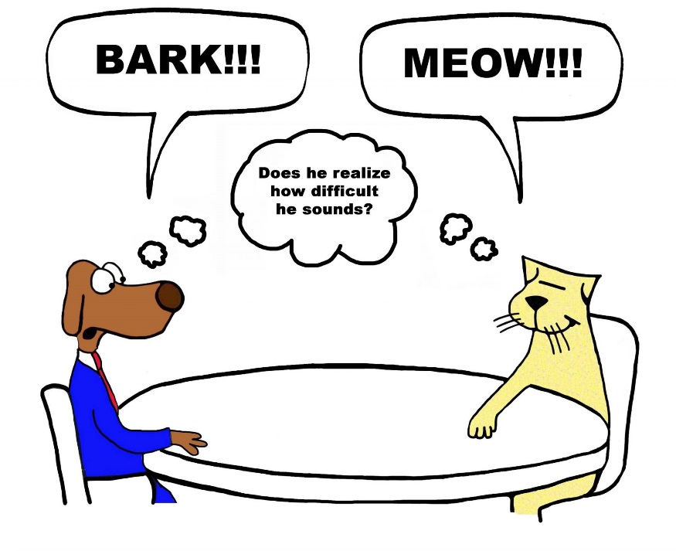
Goals for “Our” Conversation
Understand why conversations can be difficult
Assess your past success and default position
Identify preparatory steps and strategies for effective conversations
Before
During
After
Review top mistakes to avoid
Practice: Case studies

Slide 3
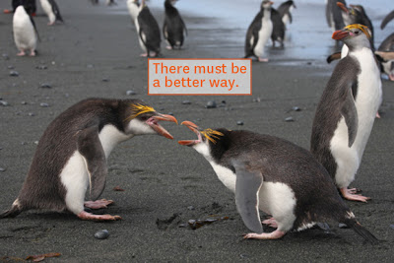
Take a minute…
Bring to mind a difficult conversation you have had in the last year as department chair.
Why was it difficult?
Did you arrive at a satisfactory conclusion?

Slide 4
Individual
Topic
Confrontation/
Conflict

Slide 5
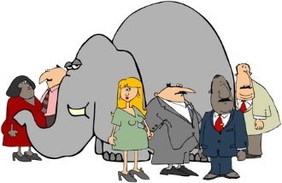
Difficult Conversations = 3 Conversations
Identity
Conversation
(with self)
What situation
means to me?
What Happened
Conversation
Who? What?
Feelings
Conversation
Mine? Other Persons?
Everyone has a
default approach

Slide 6
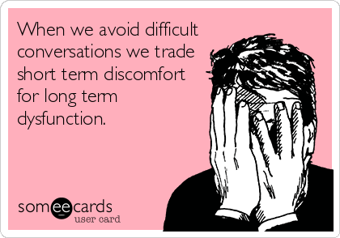
What is your typical “default” approach?
Avoidance: unsuccessful past attempts?
Fear of making situation worse – interrupting work flow?
Unsure where to start?
Too many other “important” things to do?

Slide 7
Let’s See How You Score
“Style Under Stress” Self Evaluation

Slide 8
Let’s See How You Score
“Style Under Stress” Self Evaluation
How did you score?
SILENCE or VIOLENCE
Masking
Avoiding
Withdrawing
Controlling
Labeling
Attacking

Slide 9
Typical Default Approach: Silence
SILENCE: Holding back information
Masking ⎯ Couching, sarcasm, sugarcoating
“That’s brilliant but not sure it’ll work.”
Avoiding ⎯ Sidestepping sensitive subjects
“Geez, what did you think about the Super Bowl?”
Withdrawing ⎯ Pull out of conversation
“Yikes, I need to take this call.”

Slide 10
Typical Default Approach: Violence
VIOLENCE: Verbally trying to convince or compel to your point of view
Controlling ⎯ Forcing views: overstating facts; using absolutes
“Last time we tried that it was an absolute disaster.”
Labeling ⎯ Using labels as a way to dismiss
“Don’t listen to him for Pete’s sake, he’s so reactionary.”
Attacking ⎯ Belittling, threatening
“If you run your budget in the red again, just wait & see what happens.”

Slide 11
Don’t Forget…
Conflict is INEVITABLE
Remember the Difference Between:
Conflict Resolution – NOT ALWAYS THE GOAL
Conflict Management – USUALLY THE GOAL
Conflict can be positive
Change typically grows out of conflict
Check to see if constructive feedback is “received” as such
Communication is culture-bound

Slide 12
There are 3 elements of any conflict
INTERESTS
(What parties need, desire, fear, want)
RIGHTS
(What is a fair outcome)
POWER
(Balance between parties)

Slide 13
What Works?
Before the Conversation
Start with YOU:
GOAL: Be clear about your goal and intended outcome
ASSUMPTIONS: Understand the assumptions you are making about the faculty/staff/student/parent intentions;
Impact ≠ Intent
BACKSTORY: Know your own backstory: your “buttons” – are you part of the problem?
ATTITUDE: Check your attitude about how the conversation may evolve; Think it will be horrible…it will!
NEEDS: Review the needs and personality of the individual: anticipate, anticipate, anticipate
CENTERING: Center yourself—stay in charge; control your emotional energy
Ringer, Judith. “We Have to Talk: A Step-by-Step Checklist for Difficult Conversations” http://www.mediate.com/articles/ringerj1.cfm

Slide 14
What Works
During the Conversation
Inquiry:
Pretend you don’t know anything
Acknowledgment:
Acknowledgment ≠ Agreement
Positioning:
Clarify your position
Framing Language is key!
Words
Phrases
Problem-Solving:
Build solutions
Establish action plan

Slide 15
What Works
After the Conversation
Follow these steps:
Follow up & check in
Put on calendar
Written follow-up (as appropriate)
Don’t procrastinate

Slide 16
Top Mistakes to Avoid
Winging it
Starting with an apology
Getting emotional
Avoiding confrontation
Belaboring the point
Going it alone
Picking wrong time/place
Letting conversation devolve into argument
Forgetting to assess how your message is being internalized
Not following up
Adapted from: “Difficult Conversations with Employees, A Proven Framework That Works” (Resourceful Manager; Malvern, PA 2016) http://www.resourcefulmanager.com

Slide 17
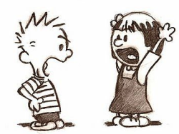
Practice Makes Perfect
Case Studies
Case Study #1: Battle of the Bulge
Case Study #2: Show Me the Money
Case Study #3: Kobayashi Maru
Case Study #4: Finish in Four
Case Study #5: Retiring in Place

Slide 18
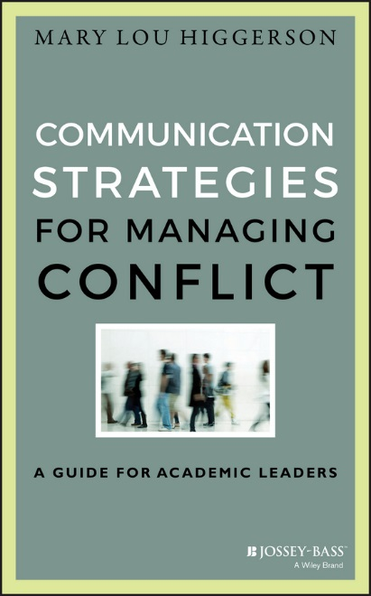
Communication Strategies for Managing Conflict A Guide for Academic Leaders Mary Lou Higgerson, 2016

