Slide 1
“Your Old Role vs. Your New Role” AITU New Department Chair Workshop Wednesday, February 6, 2019 Hyatt Regency Hotel, Houston
Bruce Bursten, Professor and former Provost
Worcester Polytechnic Institute
bbursten@wpi.edu
Formerly:
Department Chair, Chemistry, The Ohio State University
Dean of Arts and Sciences, University of Tennessee-Knoxville

Slide 2
Goals for the Session
Some of the opportunities and challenges of your new role—general for any department chair/head
Some of the opportunities and challenges of your new role—the special case of AITU institutions
Some tricks of the trade—and some recurring challenges
Hope you will leave with at least one useful nugget of information that makes your new role better
Discuss, discuss, discuss!—let’s be interactive

Slide 3
For Those of You Who Recently Took a Headship: What has Changed in Your Life?
If internal: How many of your colleagues treat you the same as before? How many differently?
Who are you comfortable talking with when you need to discuss a sensitive issue?
Have you learned something about some of your colleagues that you had not previously known (and may very well wish you hadn’t learned!)?
Are you developing a good team with whom you can work?
Are you still expecting yourself to be active as a researcher and/or teacher? If so, how are you managing your multiple roles?
Are you learning more about the flow of money at your university?
Have the letters “HR” become more important in your life?
Are you familiar with the term “managing up”?
How’s that e-mail thing working for you?
Work/life balance!

Slide 4
AITU Institutions: Some Distinctive Leadership Challenges for Discussion
We tend to be smaller, administratively lean institutions: Do you know where to find the resources you need? Are there times when you feel understaffed?
We are engineering- and science-oriented universities with aggressive research agendas: You need to work to be an enabler of the research activities of your faculty.
We often have cultures that lack the transparency of publics: Certain information, such as budgets, faculty salaries, and start-up offers, must be carefully guarded (even if you don’t want to do so).
We often have faculty who work in multi-PI and multi-disciplinary teams: Must set clear expectations for independence vs. collaboration, especially in the case of untenured assistant professors.
We tend to be largely dependent on tuition for financial well-being: Is your department committed to retaining and recruiting students (BS and MS) via strong teaching and advising platforms?
We have challenges in recruiting students and faculty from under-represented minority groups: Are you working with your colleagues to increase representation of URMs in STEM?

Slide 5
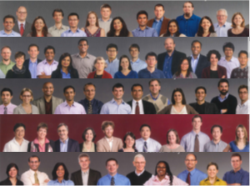
Perhaps the Biggest Opportunity/Challenge in Your New Role
People
Faculty
Other Heads
Staff
Deans, Provosts
VPs, Presidents
Donors
Your new role will likely involve much more and quite different interpersonal interactions than your old role!

Slide 6
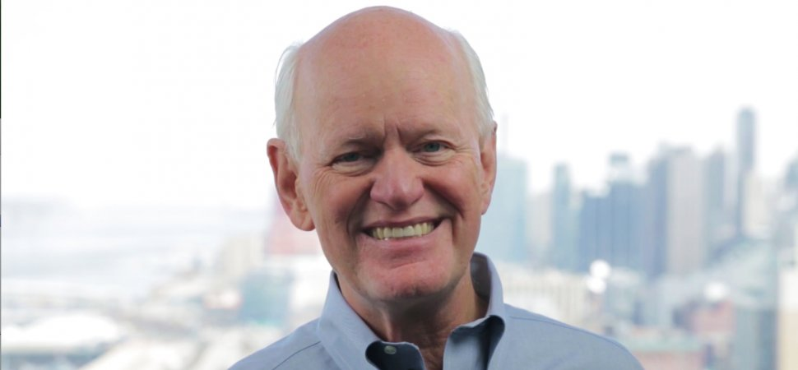
Interpersonal Behavior: A Suggested (Easy) Book to Read from a Master Coach
Some bad habits to avoid:
Winning too much—the need to win at all costs, and in all situations
Adding too much value—the overwhelming desire to add too much information to every discussion
Passing judgment—the need to rate others
Starting with “no,” “but,” or “however”—the overuse of these negative qualifiers which secretly say, “I’m right, You’re wrong.”
Speaking when angry
Negativity, or “Let me explain why that won’t work”
Making excuses
Inability to apologize
Not listening
Failing to express gratitude
(20 habits total: Well worth the reading!)

Slide 7
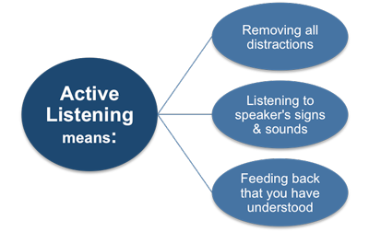
Some (Hopefully Helpful) Advice to Succeed Even Better
Even in a technically-oriented AITU institution, your most important leadership skills are people-oriented: Pay careful attention to your colleagues, your staff, and yourself!
Listen actively! No matter how good you are at multitasking—don’t do it.
Find people you can brainstorm with, whether a trusted staff member or fellow head.
Understand deeply (especially your resources), but try to avoid getting in the weeds.
Delegate and empower—you will be amazed at how good it makes others feel.
Control your calendar!—people will understand.

Slide 8
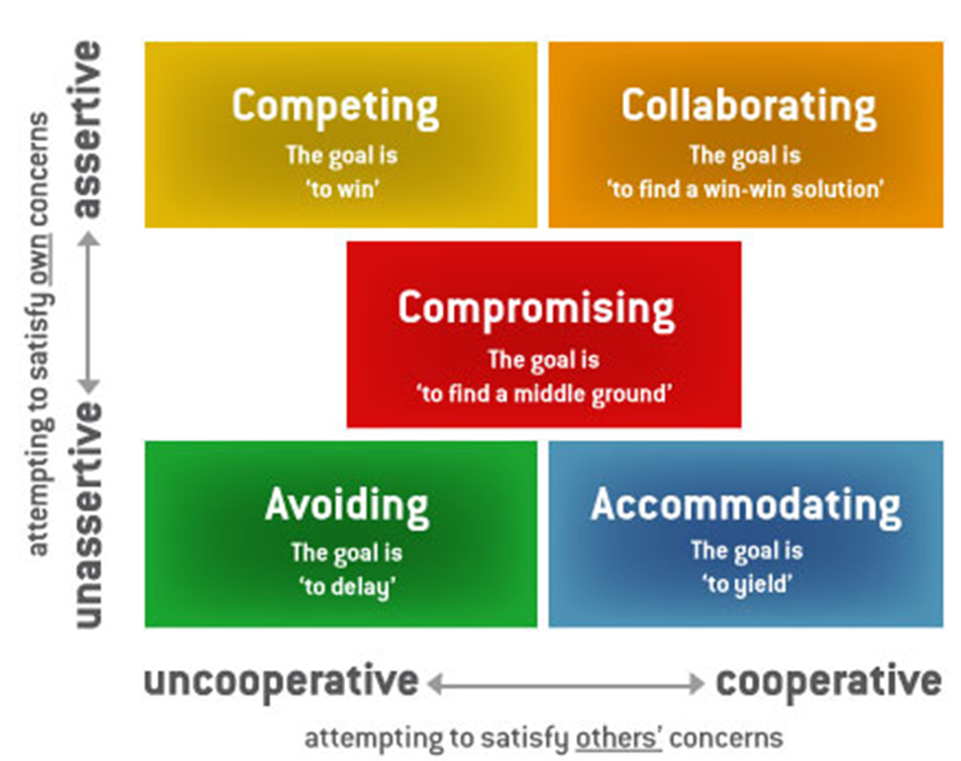
Conflict Resolution: One of the Most Important Parts of Your New Role
Some suggested homework: Read more about the Thomas-Kilmann Conflict Mode Instrument (TKI)
TKI assesses typical behavior in conflict situations and describes it along two dimensions: Assertiveness and Cooperativeness

Slide 9
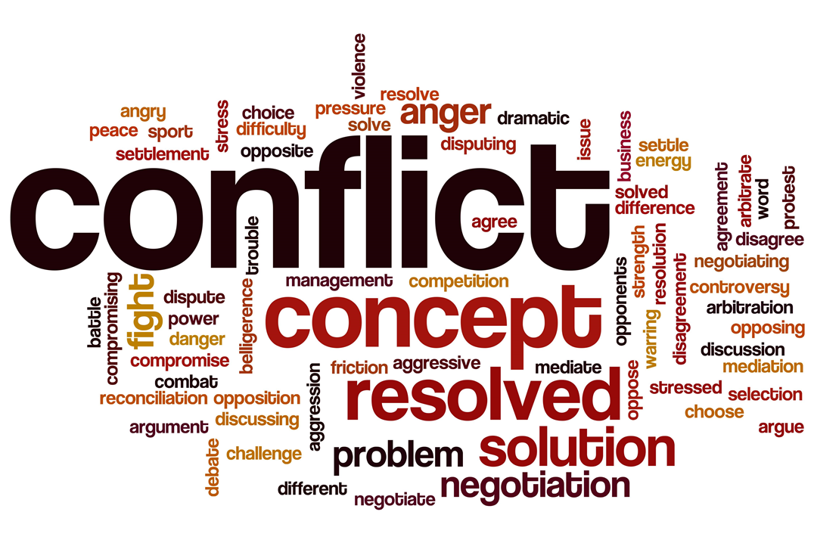
The Five TKI Modes of Dealing with Conflict
The two dimensions of TKI conflict behavior:
Assertiveness (A) and Cooperativeness (C)
Five basic styles of dealing with conflict, and each has a different goal:
Avoiding (low A, low C)—the goal is to delay
Competing (high A, low C)—the goal is to win
Accommodating (low A, high C)—the goal is to yield
Collaborating (high A, high C)—the goal is a win-win solution
Compromising—the goal is to find a middle ground
Q: Which of these conflict modes is the most effective?
A: Each is effective in different situations!

Slide 10
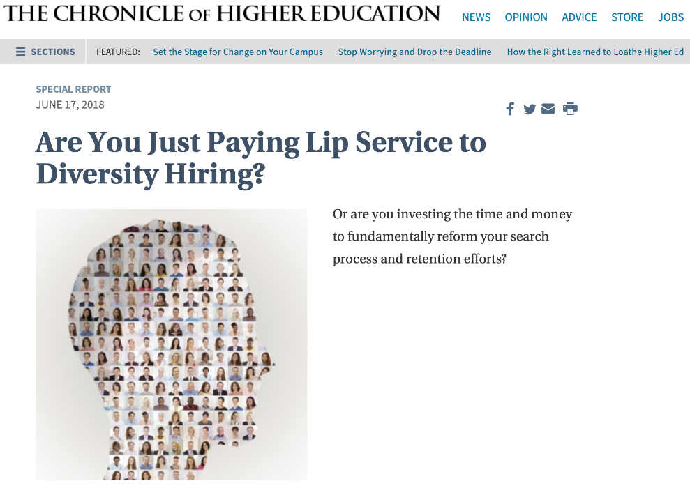
Improving the Diversity of your Department: An Opportunity for Leadership
You can (and need!) to make a difference in the culture of your Department:
Challenges in diverse faculty hiring (especially at AITU schools):
Size of the candidate pool in STEM disciplines—an issue, not an excuse!
Implicit bias—need to push your colleagues (and perhaps yourself) beyond comfort levels
Mentoring and role models—optimizing successful outcomes

Slide 11
And Finally…the Bane of My Existence (and Likely Yours, As Well)
Current count of my messages in my Inbox:
12,451
(and, yes, I do file like mad!)
2,873
Somewhat ironic—caused in part by:
Active listening—being present in meetings.
Wanting to be accessible—and hence too many meetings!
Attempting (and often failing) at work-life balance.
For me, a true love-(not love) relationship…
Some helpful reading and listening:

Slide 12
Some Concluding Comments
Welcome to your new role! It truly makes a difference to your department and university to have good and true leadership.
As you transition from “plain vanilla professor” to “department head,” continually take stock of the new and exciting opportunities you now get to have.
Your colleagues want you to succeed and will help you do so. Really.
Network with your AITU colleagues and others at this conference. You will find it remarkably comforting to find out that you are not alone in dealing with some of the “stuff” that comes your way.
View your new position as a privilege that some of your colleagues will never have (including some of them who want it very badly).
Be mindful of succession planning: Can you identify, and eventually mentor, colleagues who might follow you into departmental leadership?
Always, always, always keep things in perspective! Do your best, don’t lose (too much) sleep, and remember that academia is still the best and most meaningful place to work.
Additional Discussion?

